Slide 1
Calculus
Week 1
Zamina Alizada

Slide 2
Functions

Slide 3
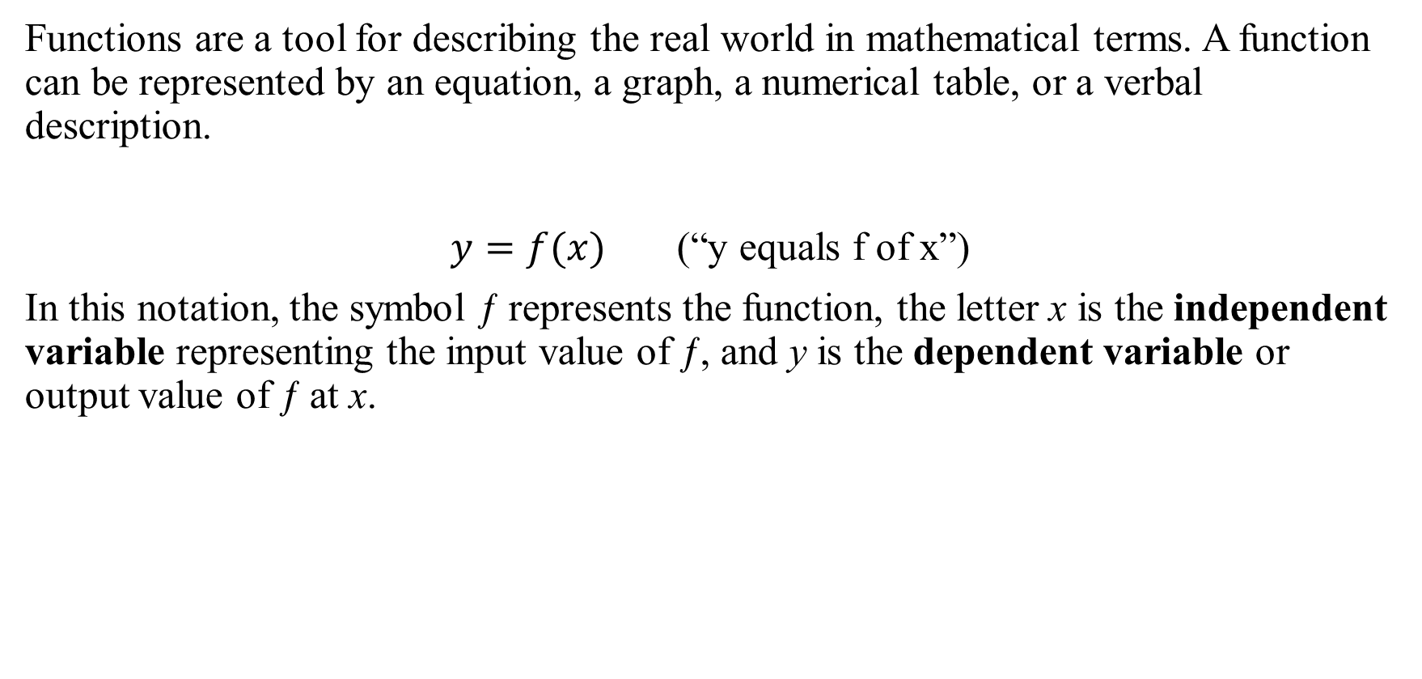
Functions are a tool for describing the real world in mathematical terms. A function can be represented by an equation, a graph, a numerical table, or a verbal description.
$y=f(x)$ (“y equals f of x”)
In this notation, the symbol ƒ represents the function, the letter x is the independent variable representing the input value of ƒ, and y is the dependent variable or output value of ƒ at x.

Slide 4

Domain and range
Definition: A function ƒ from a set D to a set Y is a rule that assigns a unique (single) element $f(x)∈Y$ to each element $x∈D$.
The set D of all possible input values is called the domain of the function. The set of all values of ƒ(x) as x varies throughout D is called the range of the function

Slide 5
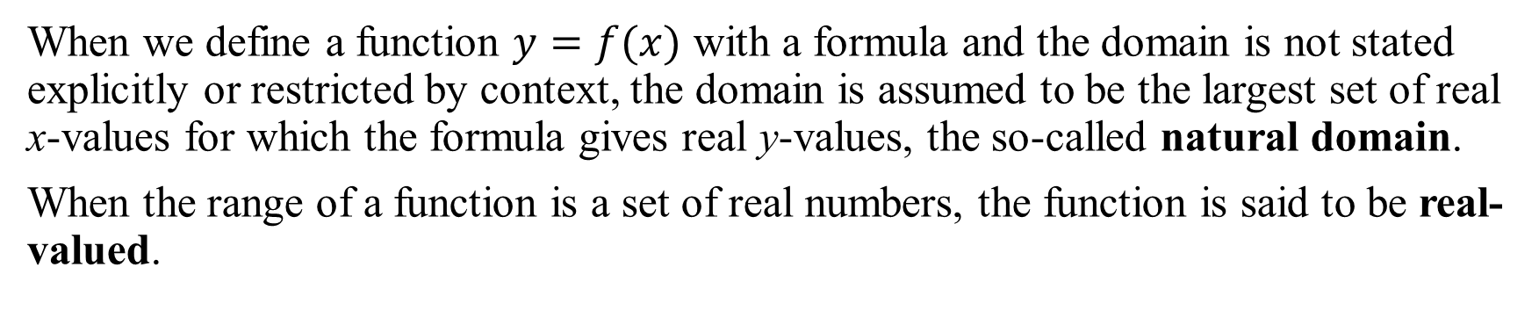
When we define a function $y=f(x)$ with a formula and the domain is not stated explicitly or restricted by context, the domain is assumed to be the largest set of real x-values for which the formula gives real y-values, the so-called natural domain.
When the range of a function is a set of real numbers, the function is said to be real-valued.

Slide 8
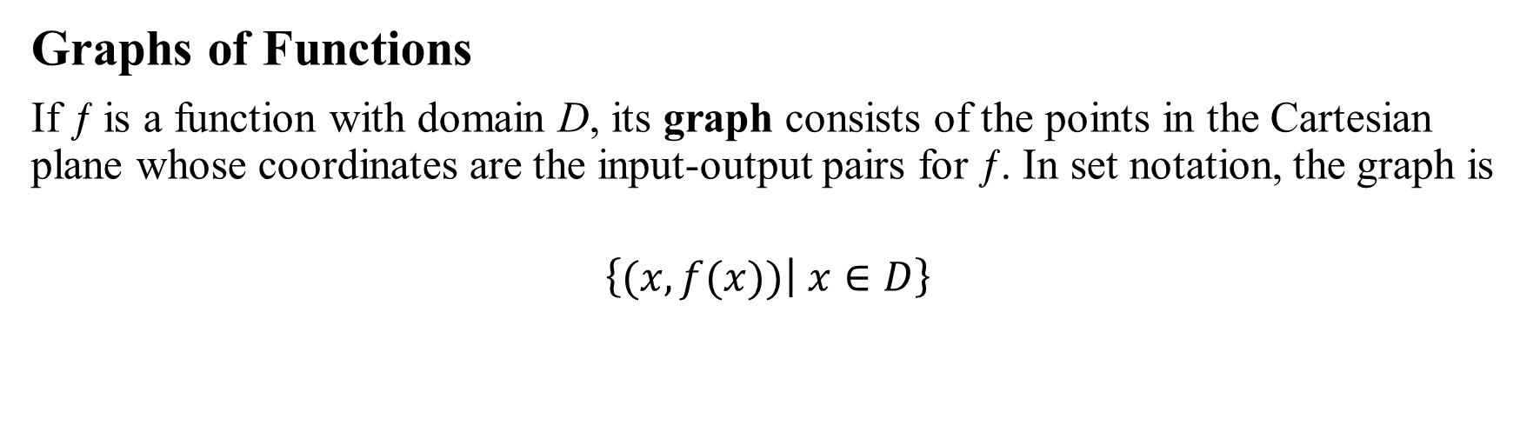
Graphs of Functions
If ƒ is a function with domain D, its graph consists of the points in the Cartesian plane whose coordinates are the input-output pairs for ƒ. In set notation, the graph is
$$\left\{\left.(x,f(x))\right| x∈D\right\}$$

Slide 10
Representing a Function Numerically
Another way to represent a function is numerically, through a table of values. Numerical representations are often used by engineers and scientists. The graph consisting of only the points in the table is called a scatterplot.

Slide 11
Example 3
Musical notes are pressure waves in the air. The data in Table 1.1 give recorded pressure displacement versus time in seconds of a musical note produced by a tuning fork. The table provides a representation of the pressure function over time. If we first make a scatterplot and then connect approximately the data points (t, p) from the table, we obtain the graph shown in Figure 1.6.

Slide 12
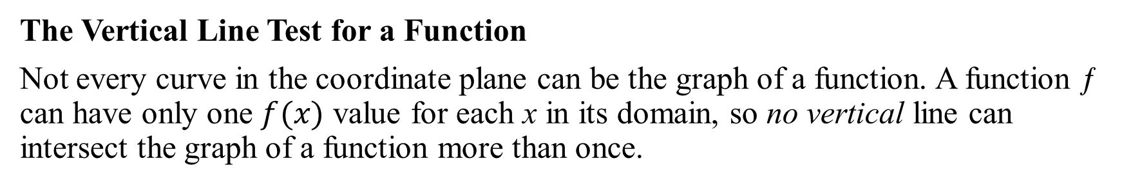
The Vertical Line Test for a Function
Not every curve in the coordinate plane can be the graph of a function. A function ƒ can have only one $f(x)$ value for each x in its domain, so no vertical line can intersect the graph of a function more than once.

Slide 13
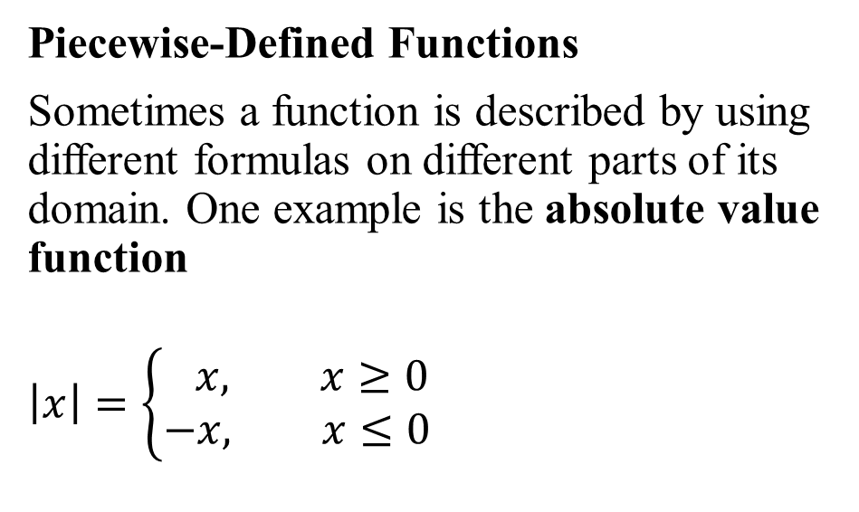
Piecewise-Defined Functions
Sometimes a function is described by using different formulas on different parts of its domain. One example is the absolute value function
$$\left|x\right|=\left\{\begin{aligned} x, x≥0 \\ −x, x≤0\end{aligned}\right.$$

Slide 15
Increasing and Decreasing Functions

Slide 16
Even Functions and Odd Functions: Symmetry
The graph of an even function is symmetric about the y-axis.
The graph of an odd function is symmetric about the origin.

Slide 18
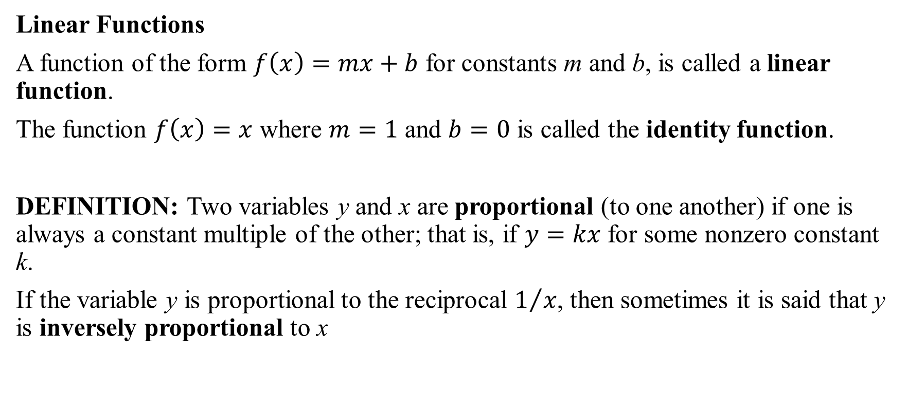
Common Functions
Linear Functions
A function of the form $f\left(x\right)=mx+b$ for constants m and b, is called a linear function.
The function $f\left(x\right)=x$ where $m=1$ and $b=0$ is called the identity function.
DEFINITION: Two variables y and x are proportional (to one another) if one is always a constant multiple of the other; that is, if $y=kx$ for some nonzero constant k.
If the variable y is proportional to the reciprocal $1/x$, then sometimes it is said that y is inversely proportional to x

Slide 19
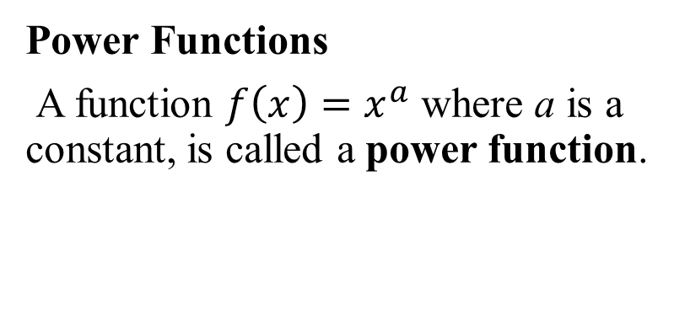
Common Functions
Power Functions
A function $f\left(x\right)=x^{a}$ where a is a constant, is called a power function.

Slide 21
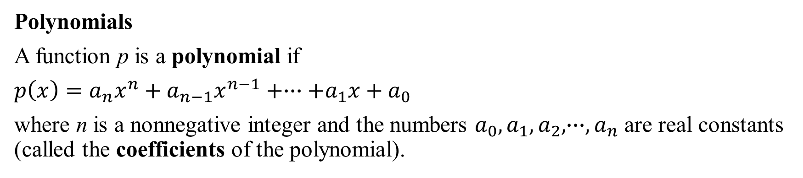
Common Functions
Polynomials
A function p is a polynomial if
$p\left(x\right)=a_{n}x^{n}+a_{n−1}x^{n−1}+∙∙∙+a_{1}x+a_{0}$
where n is a nonnegative integer and the numbers $a_{0},a_{1},a_{2}, ∙∙∙,a_{n}$ are real constants (called the coefficients of the polynomial).

Slide 22
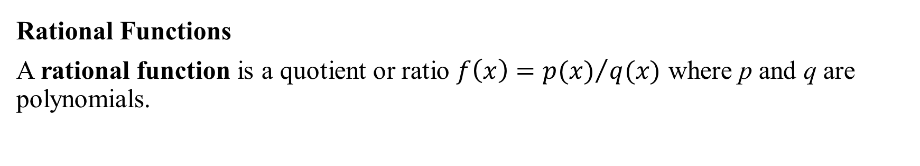
Common Functions
Rational Functions
A rational function is a quotient or ratio $f\left(x\right)={p(x)}/{q(x)}$ where p and q are polynomials.

Slide 23
Common Functions
Algebraic Functions
Any function constructed from polynomials using algebraic operations (addition, subtraction, multiplication, division, and taking roots) lies within the class of algebraic functions.
Trigonometric Functions

Slide 24
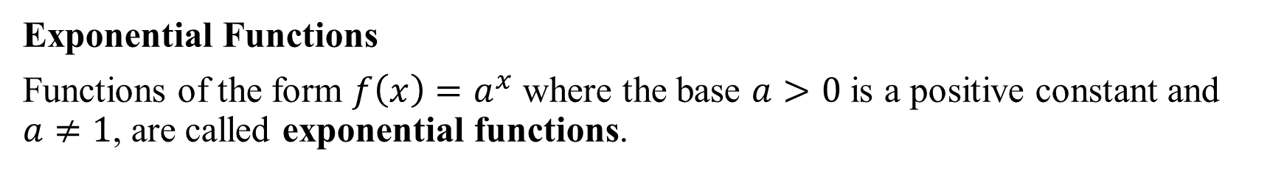
Common Functions
Exponential Functions
Functions of the form $f\left(x\right)=a^{x}$ where the base $a>0$ is a positive constant and $a≠1$, are called exponential functions.

Slide 25
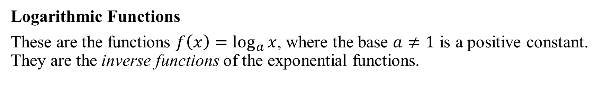
Common Functions
Logarithmic Functions
These are the functions $f\left(x\right)=\log_{a}{x}$, where the base $a≠1$ is a positive constant. They are the inverse functions of the exponential functions.

Slide 26
Common Functions
Transcendental Functions
These are functions that are not algebraic. They include the trigonometric, inverse trigonometric, exponential, and logarithmic functions, and many other functions as well. A particular example of a transcendental function is a catenary.

Slide 27
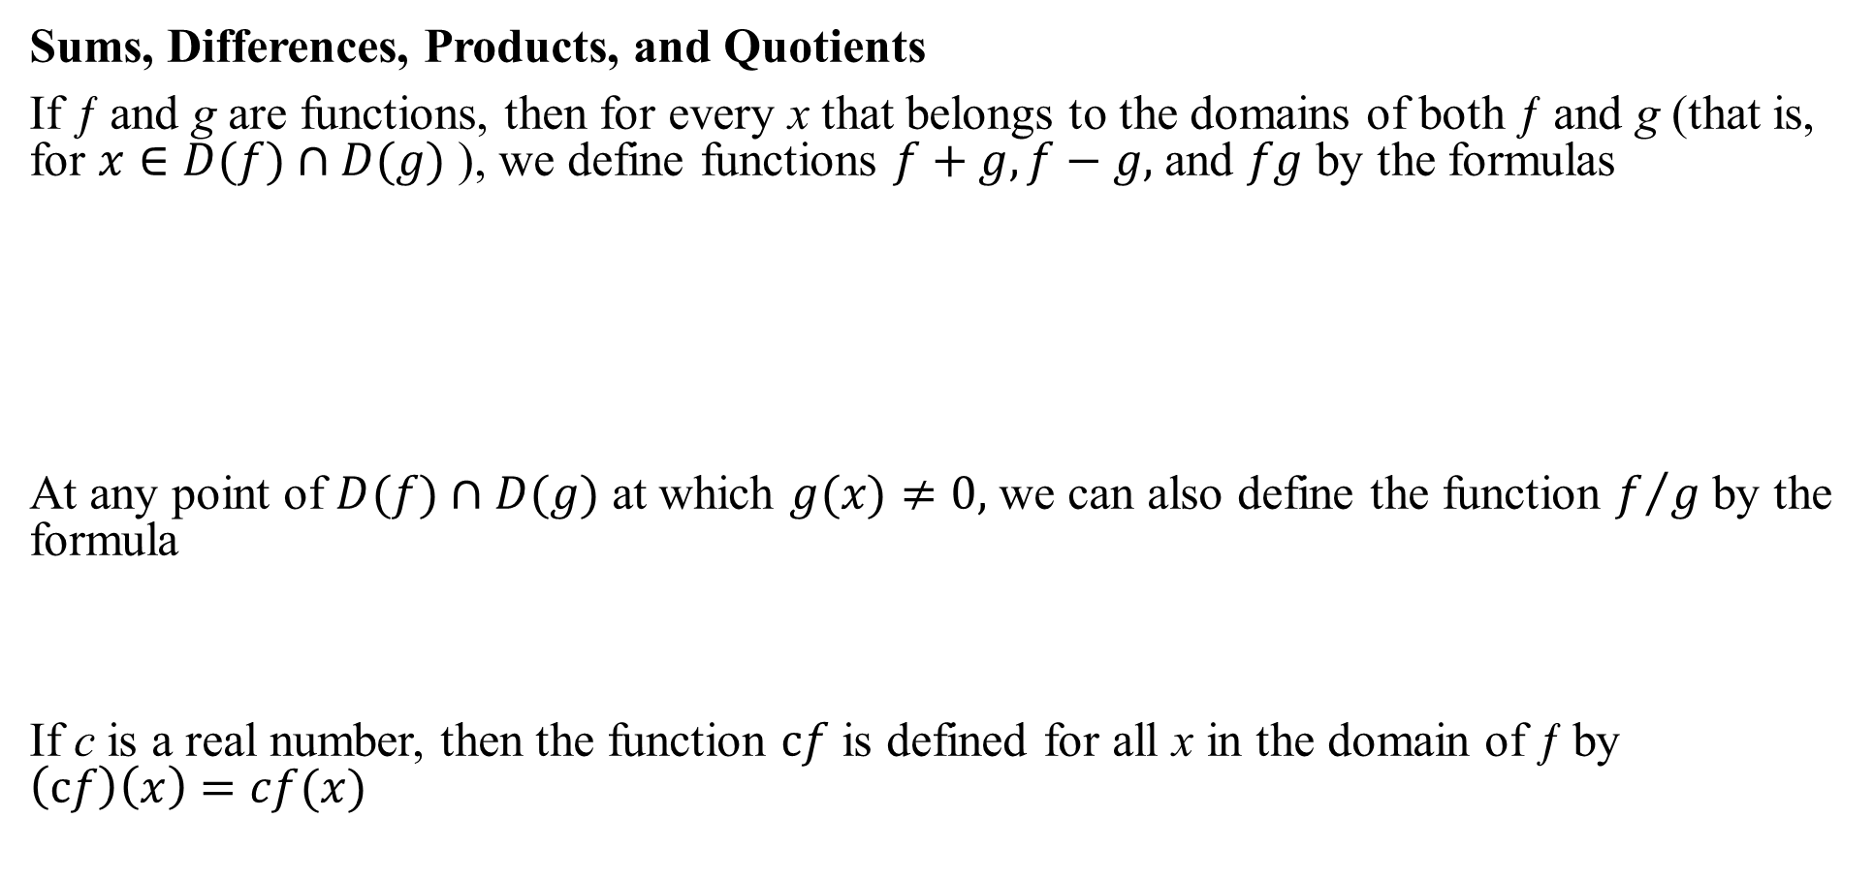
Combining Functions; Shifting and Scaling Graphs
Sums, Differences, Products, and Quotients
If ƒ and g are functions, then for every x that belongs to the domains of both ƒ and g (that is, for $x∈D(f)∩D(g)$ ), we define functions $f+g, f−g,$ and $fg$ by the formulas
At any point of $D(f)∩D(g)$ at which $g(x)≠0,$ we can also define the function $f/g$ by the formula
If c is a real number, then the function $cf$ is defined for all x in the domain of ƒ by $\left(cf\right)\left(x\right)=cf(x)$

Slide 29
Composite Functions

Slide 32
Shifting a Graph of a Function

Slide 34
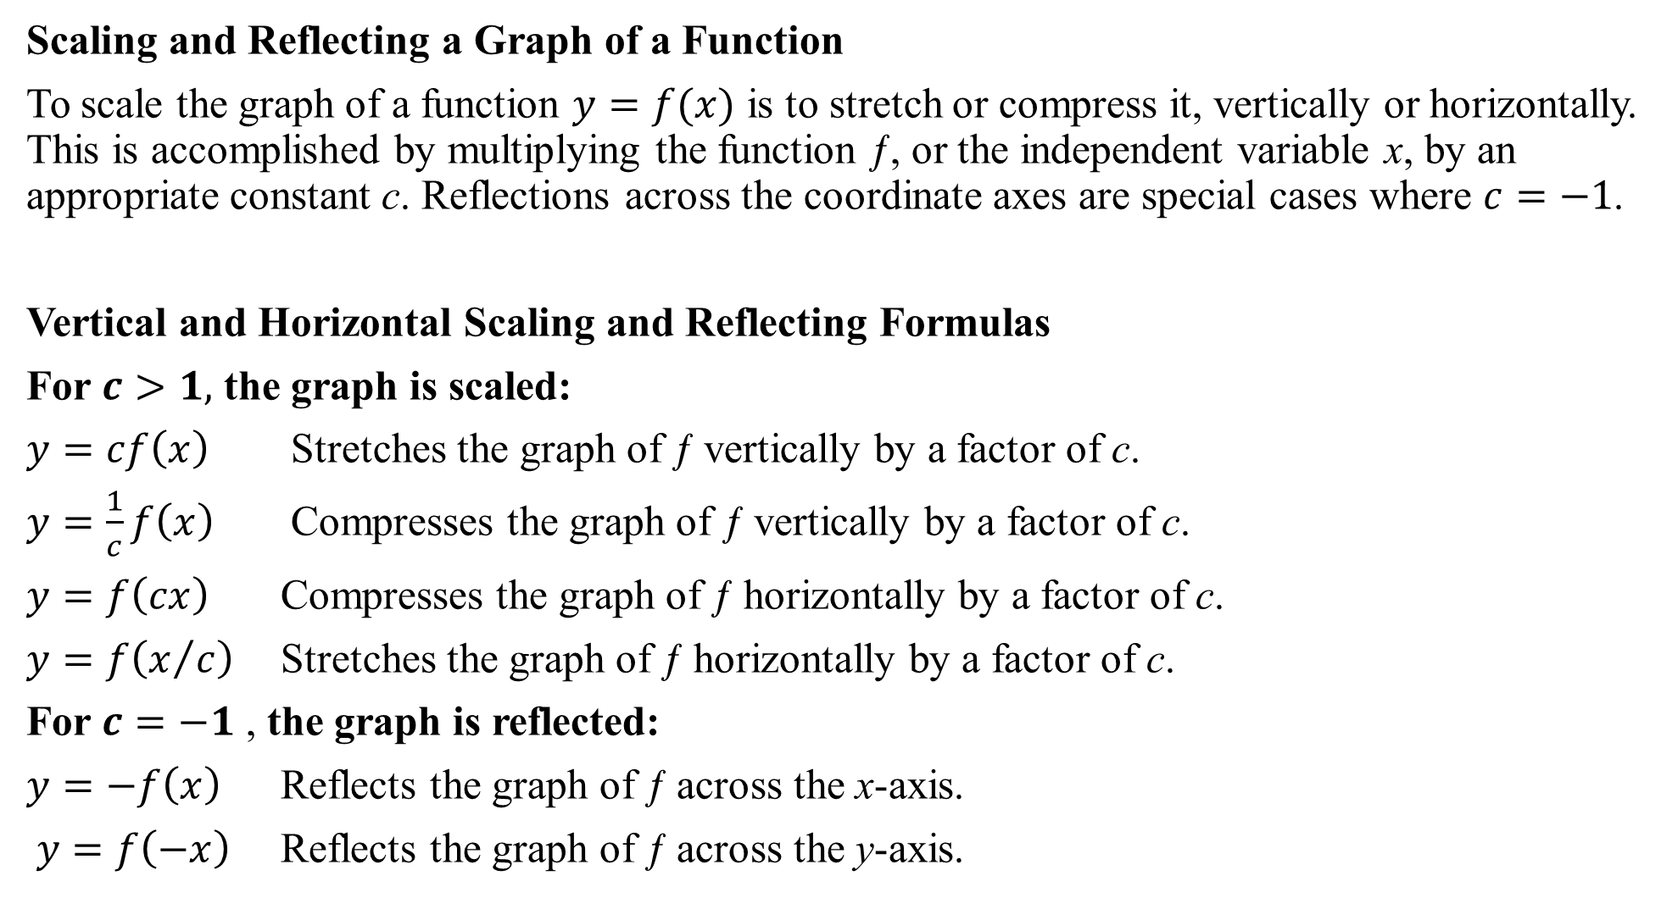
Scaling and Reflecting a Graph of a Function
To scale the graph of a function $y=f(x)$ is to stretch or compress it, vertically or horizontally. This is accomplished by multiplying the function ƒ, or the independent variable x, by an appropriate constant c. Reflections across the coordinate axes are special cases where $c=−1$.
Vertical and Horizontal Scaling and Reflecting Formulas
For $c>1,$ the graph is scaled:
$y=cf\left(x\right)$ Stretches the graph of ƒ vertically by a factor of c.
$y=\frac{1}{c}f\left(x\right)$ Compresses the graph of ƒ vertically by a factor of c.
$y=f\left(cx\right)$ Compresses the graph of ƒ horizontally by a factor of c.
$y=f\left(x/c\right)$ Stretches the graph of ƒ horizontally by a factor of c.
For $c=−1$ , the graph is reflected:
$y=−f\left(x\right)$ Reflects the graph of ƒ across the x-axis.
$y=f\left(−x\right)$ Reflects the graph of ƒ across the y-axis.

Slide 37
One-to-One Functions

Slide 39
Inverse Functions

Slide 41
Composing a function and its inverse has the same effect as doing nothing.

